Slide 1
Farm2Store
Presented By:
Lodha Dhruvil
Sadhu Chirag

Slide 2
Acknowledgement
Farm2Store is a web-based platform designed to connect farmers directly with retailers, eliminating the middlemen and ensuring better pricing and transparency for both parties. The platform enables farmers to list their products, while retailers can browse, purchase, and track orders.
Objectives
Empower farmers to sell their produce online.
Provide retailers with a reliable and fresh source of farm products.
Ensure transparency in pricing and transaction history.
Provide an admin panel for effective system management.

Slide 3
Introduction
Our innovative online platform is designed to directly connect farmers with shopkeepers and stores, cutting out the middlemen.
This platform aims to bridge the gap between farmers and shopkeepers, ensuring that fresh produce reaches consumers directly, enhancing the farm-to-store experience.
Eliminating intermediaries fosters a more transparent supply chain, reducing market manipulation and pricing issues.

Slide 4
Tools And Technology
Frontend : React Js , Axios , css
Backend : Node Js , Express Js
Database : Mysql
Tools : vs code , Xampp

Slide 5
Client-Side Requirements
Operating System : Windows 7 or Higher
Browser : Internet Explorer 8 Or Higher, Edge, Firefox 28 or Higher, Google Chrome 34 Or Higher
Processor : Core i3 or higher
RAM : 8 GB
Hard Disk : 512 GB

Slide 6
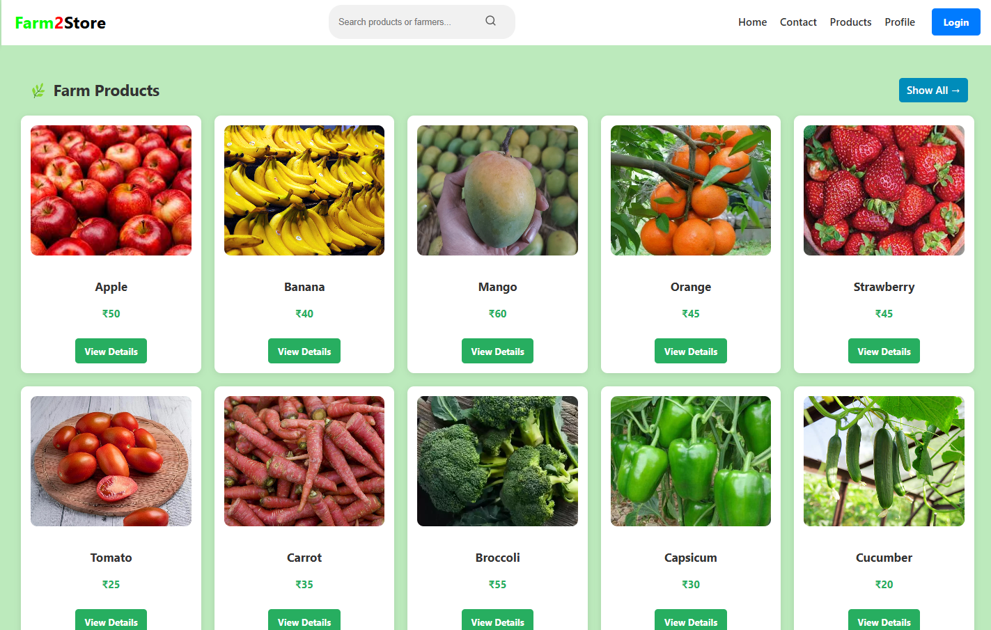
Home Page

Slide 7
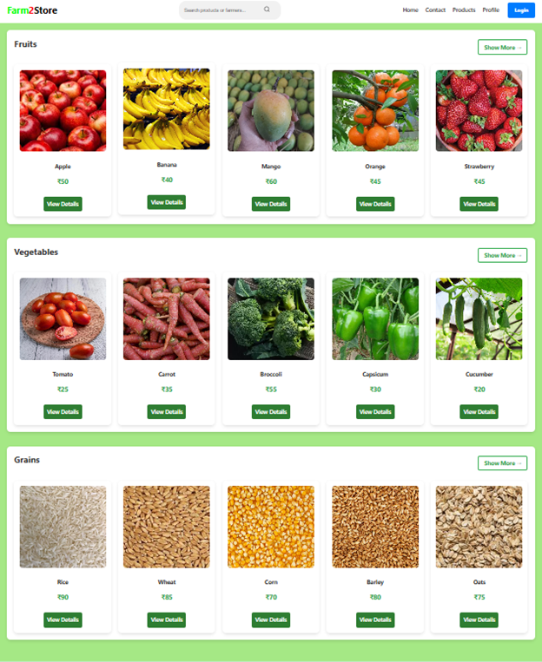
Products page:
Retailer can search products according to category.

Slide 8
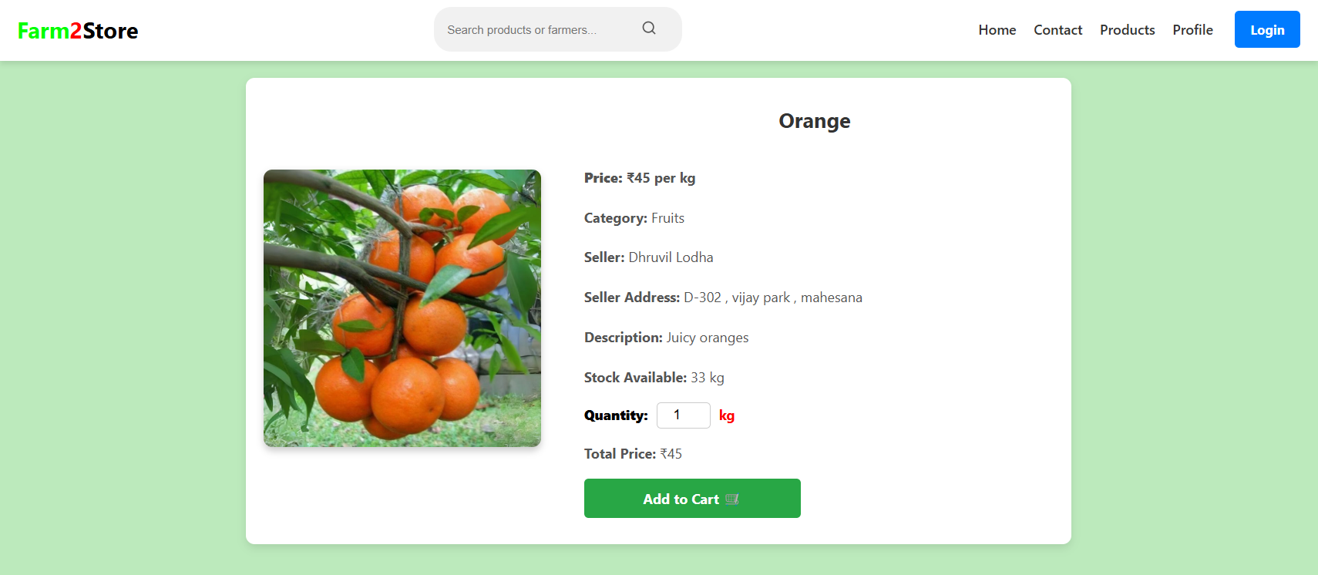
Product
details

Slide 9
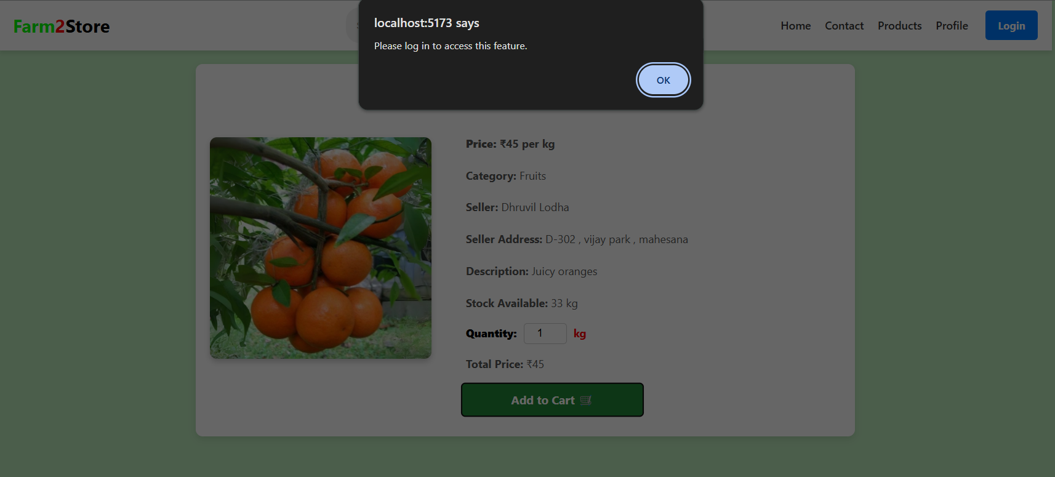
Without login user can not add product to cart

Slide 10
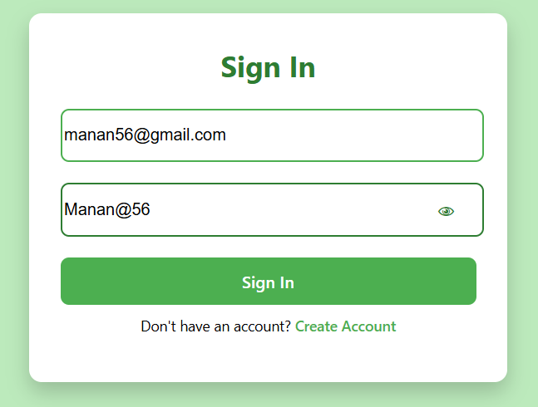
Login Page:

Slide 11
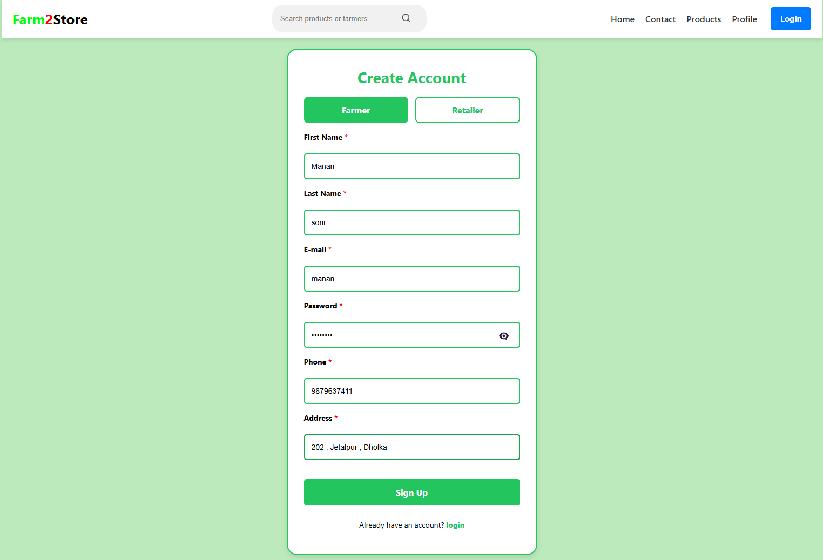
Registration Page

Slide 12
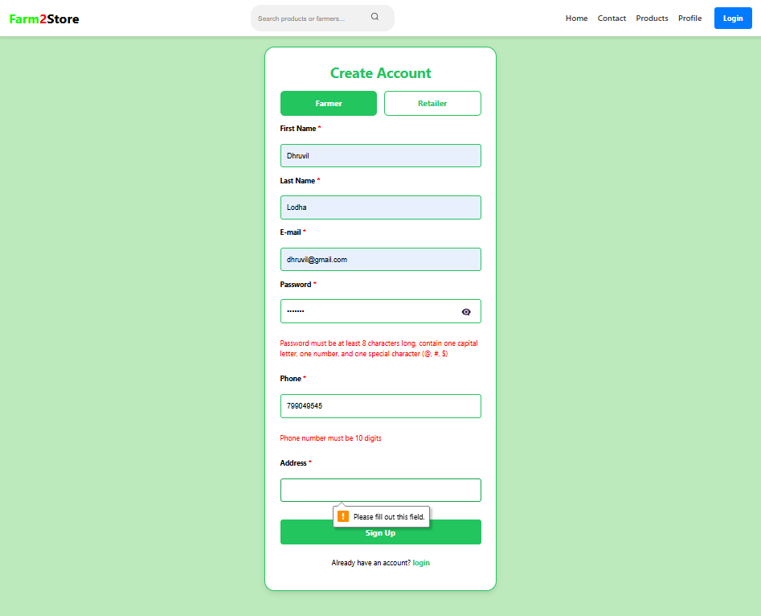
Registration Page
With validation

Slide 13
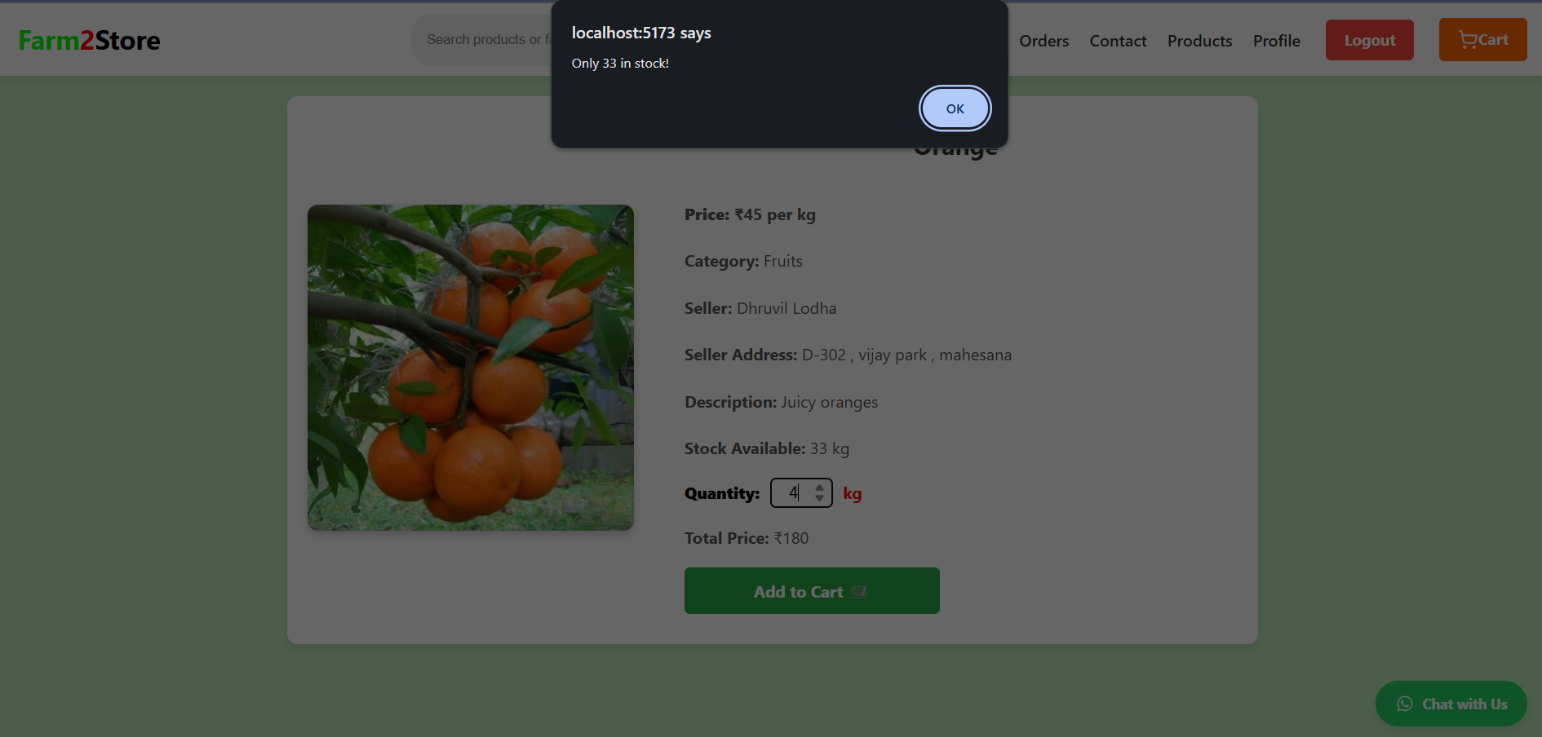
User cannot add product to cart than quantity available

Slide 14
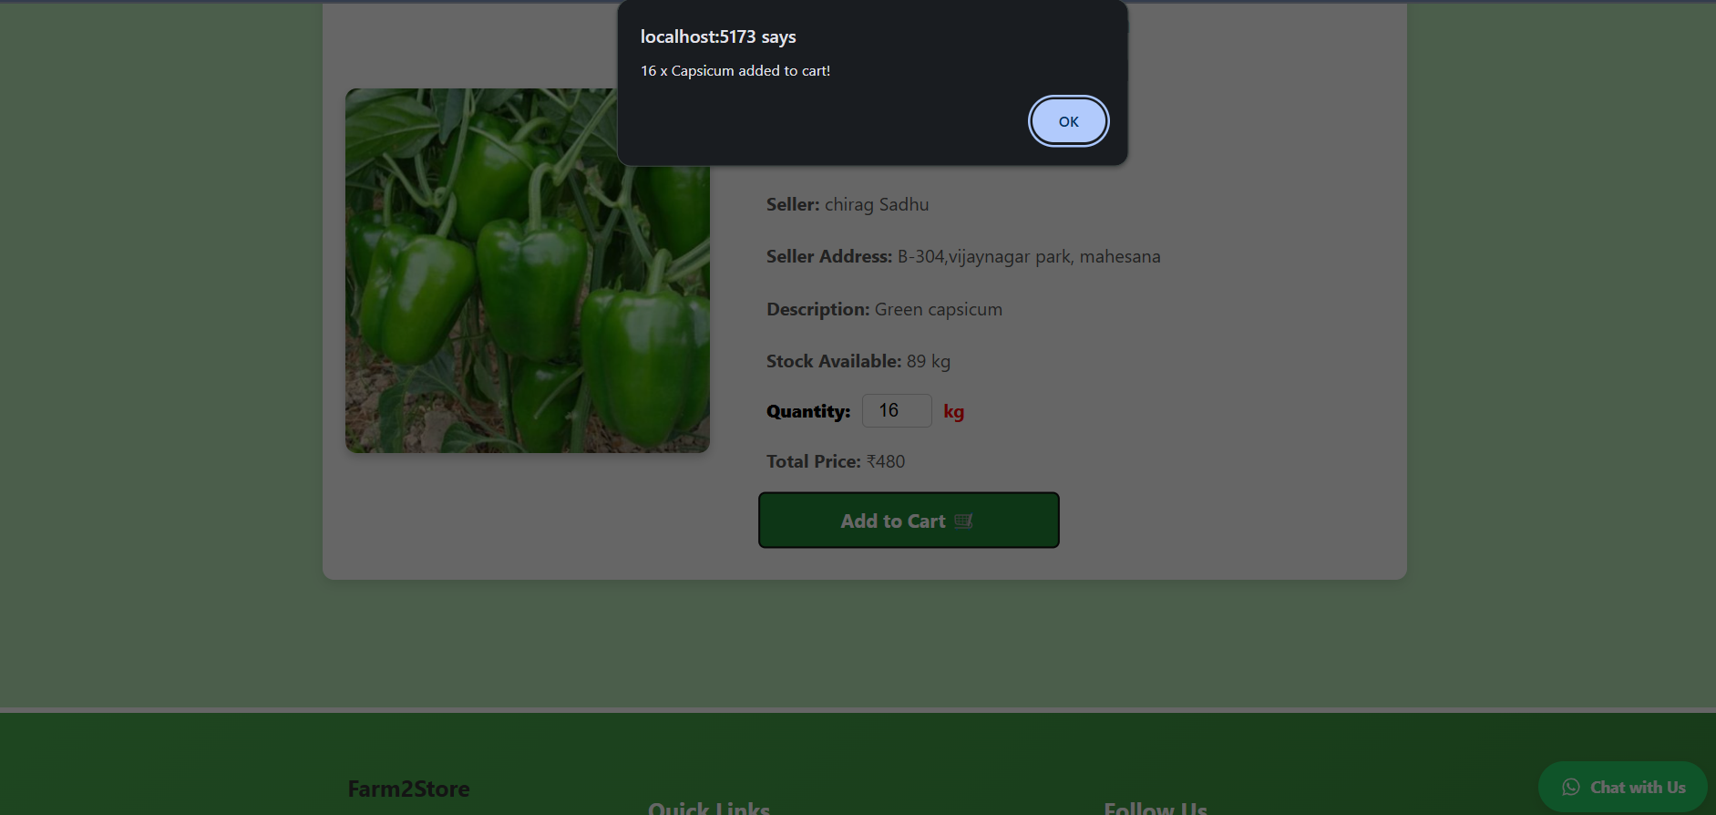

Slide 15
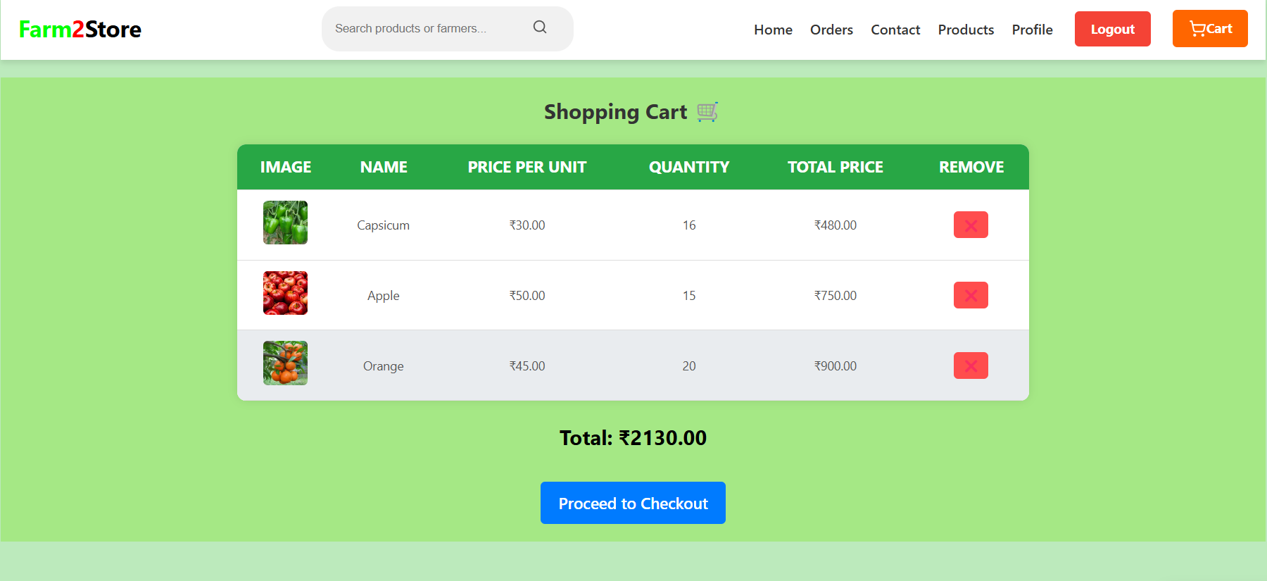
Cart Page

Slide 16
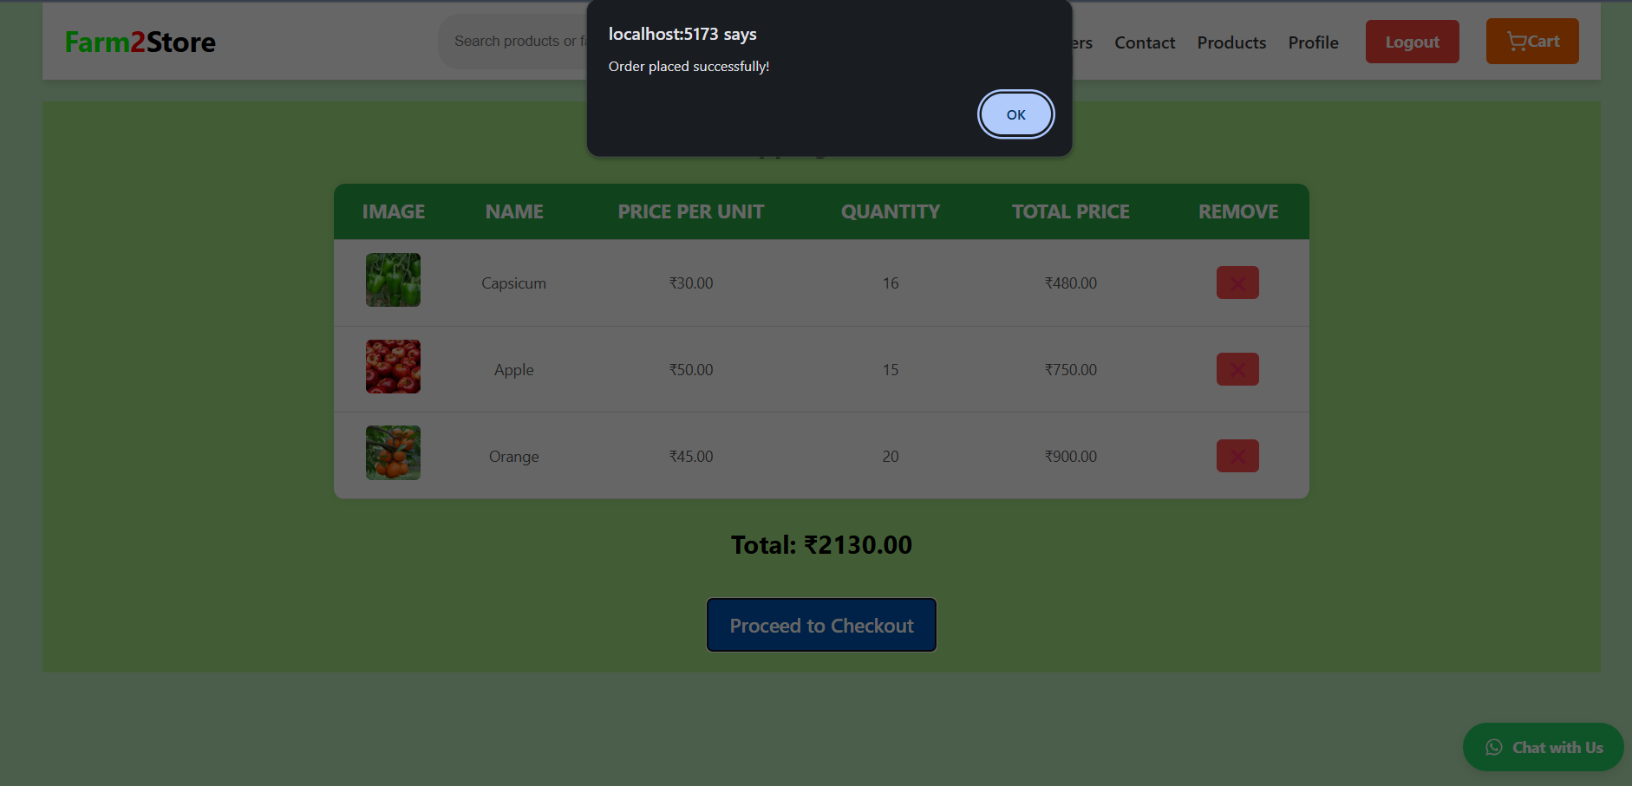

Slide 17
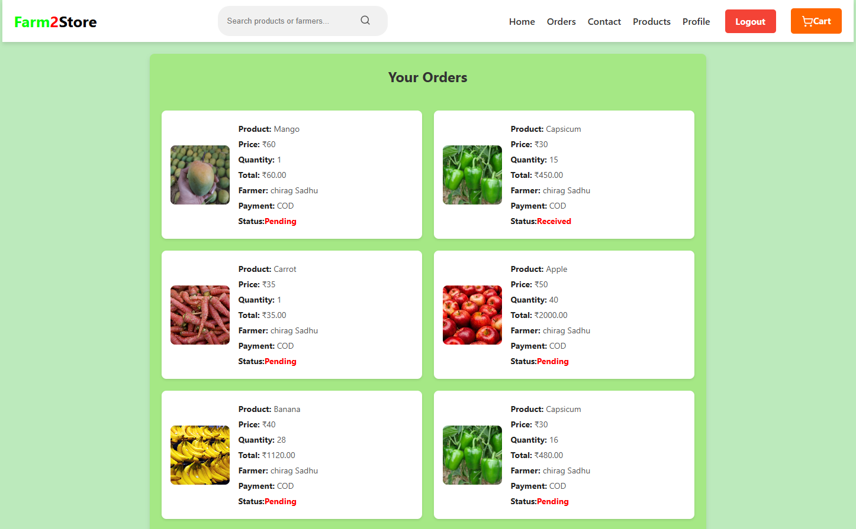
Order page

Slide 18
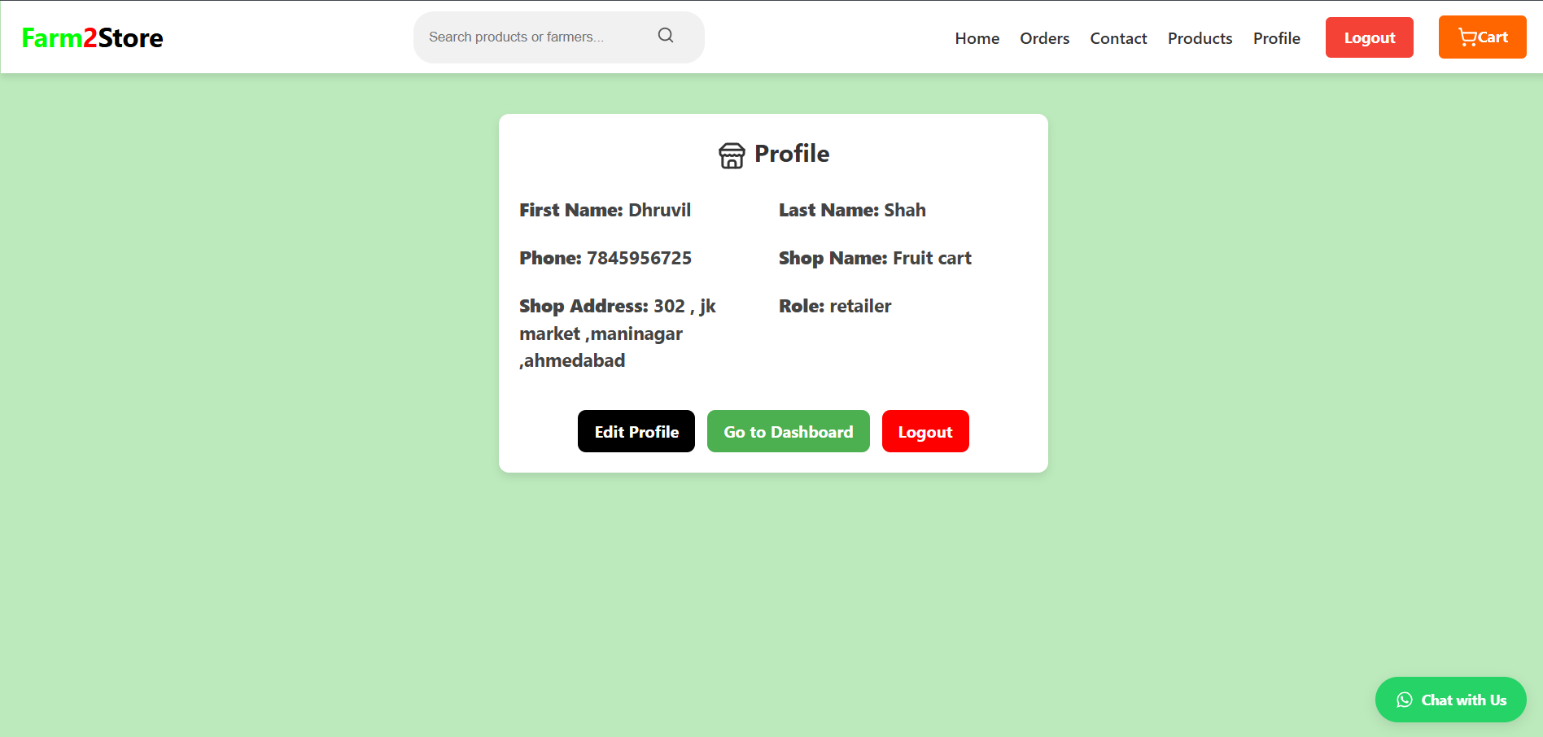
Profile Page: (Retailer)

Slide 19
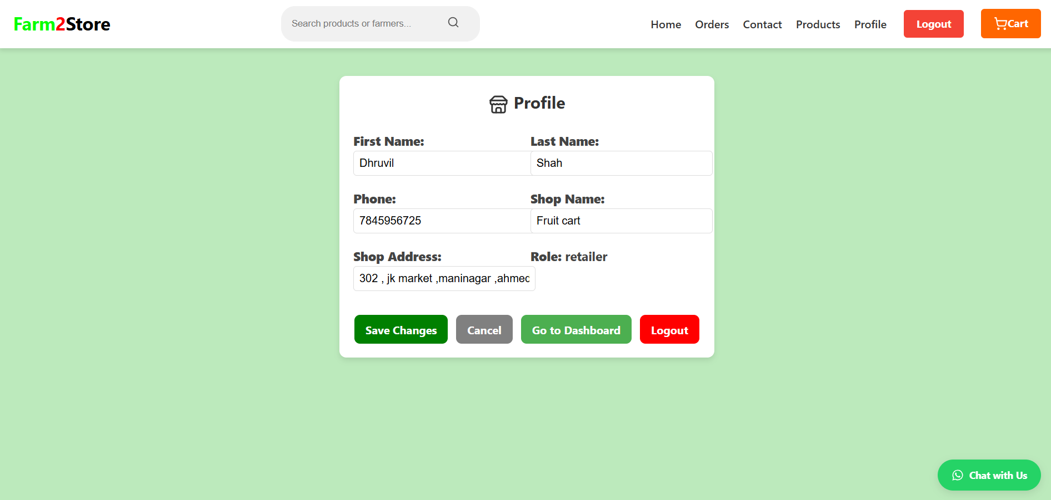
Profile Page Edit: (Retailer)

Slide 20
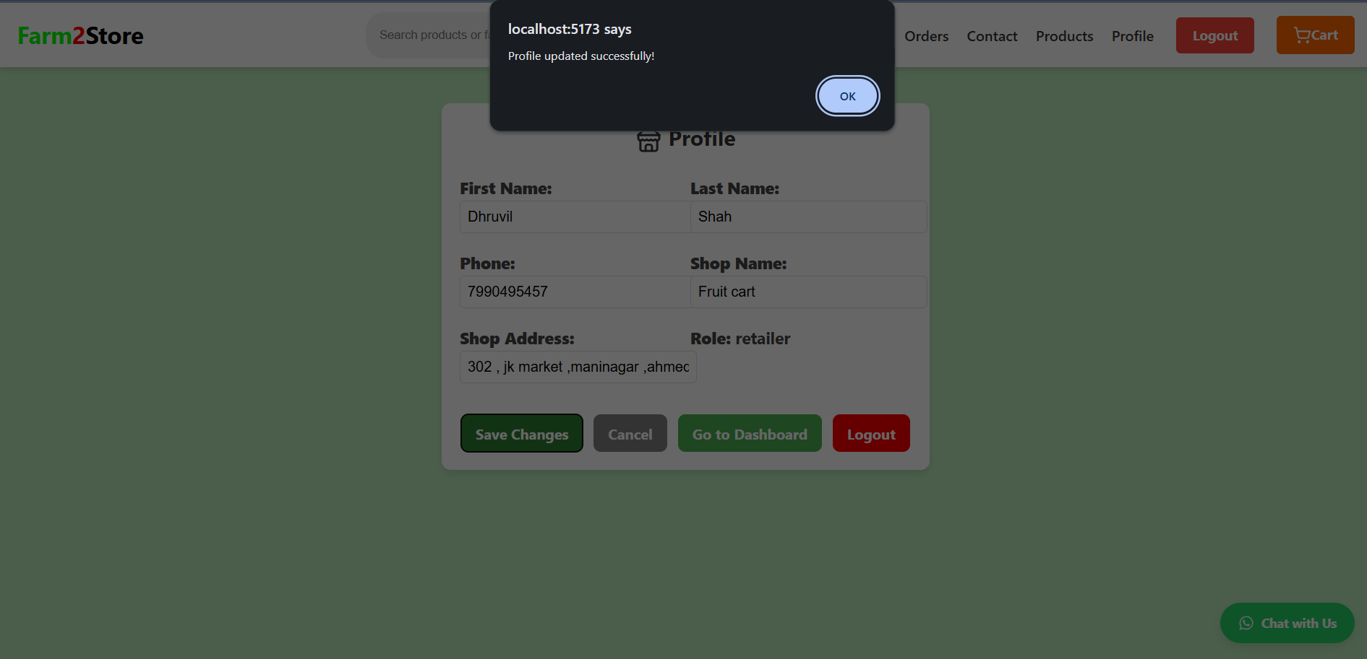
Profile Page Edit: (Retailer)

Slide 21
Retailer Dashboard

Slide 22
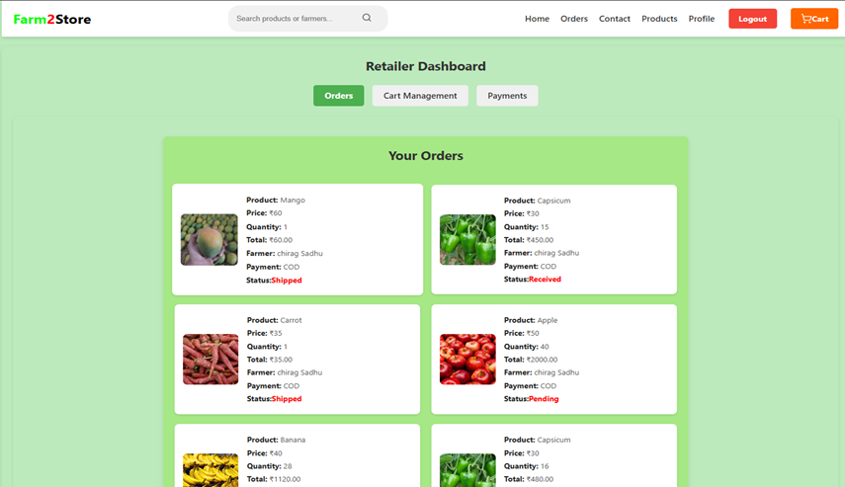
Retailer Dashboard

Slide 23
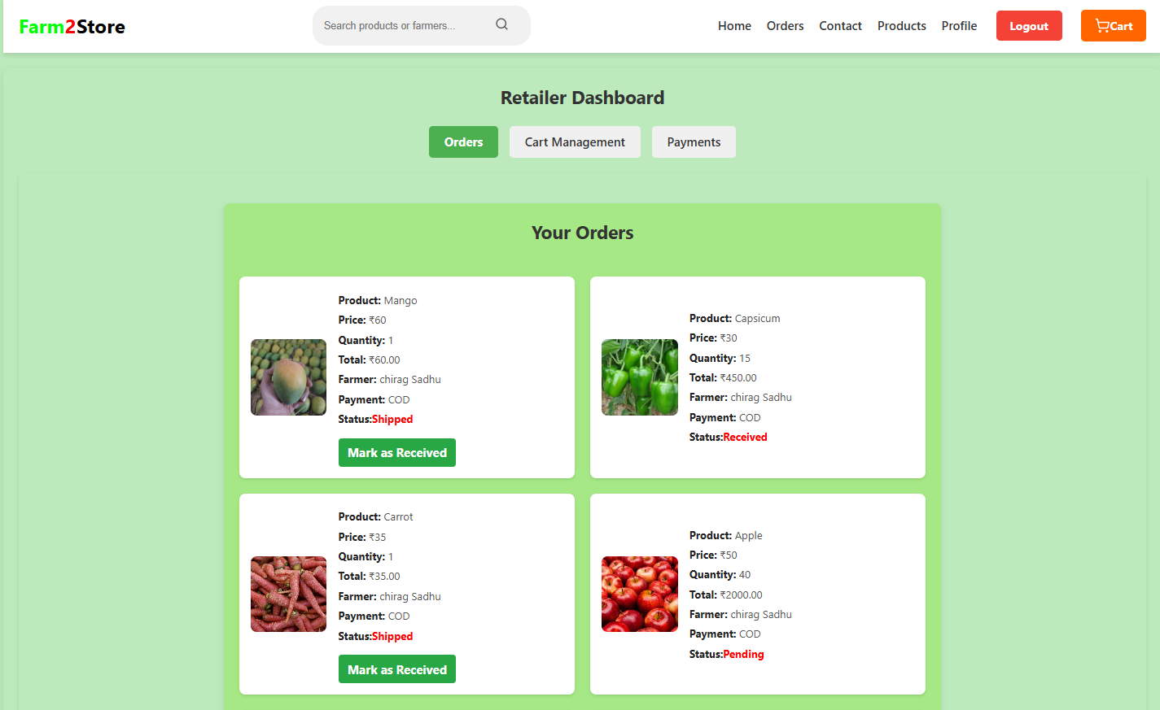
Retailer Dashboard

Slide 24
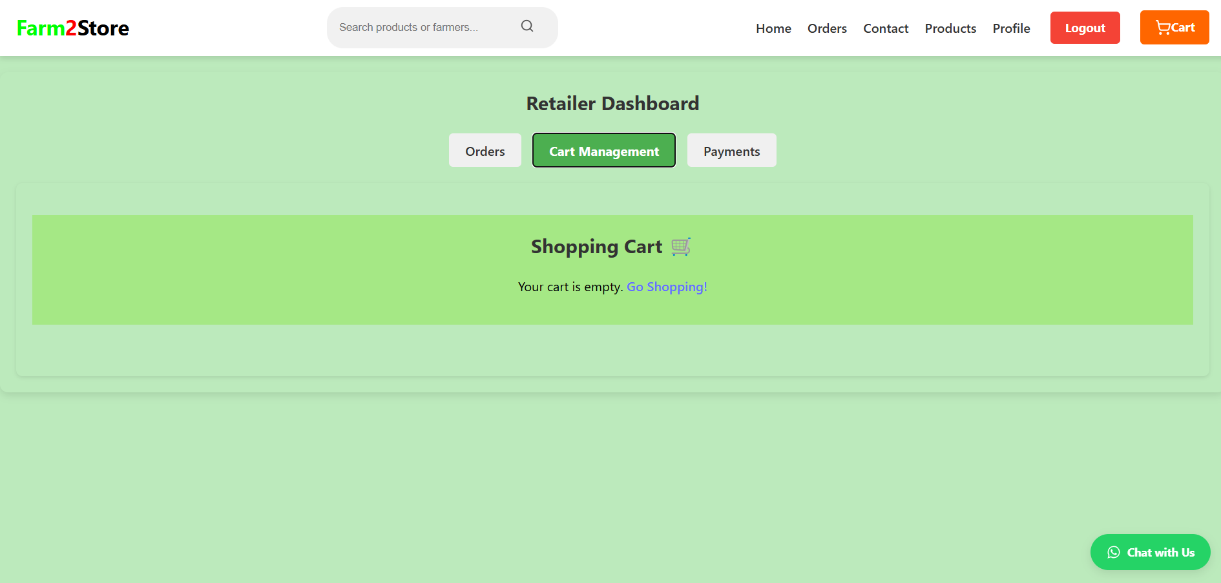
Retailer Dashboard

Slide 25
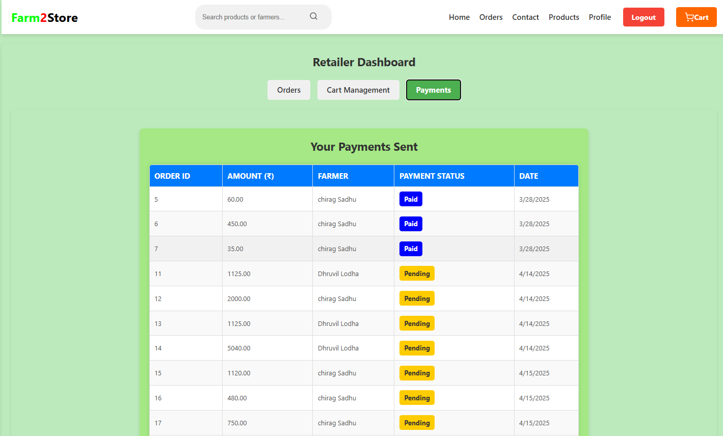
Retailer Dashboard

Slide 26
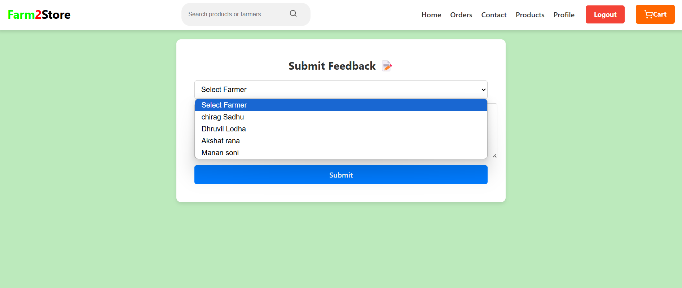
Retailer Provide Feedback to farmer

Slide 27
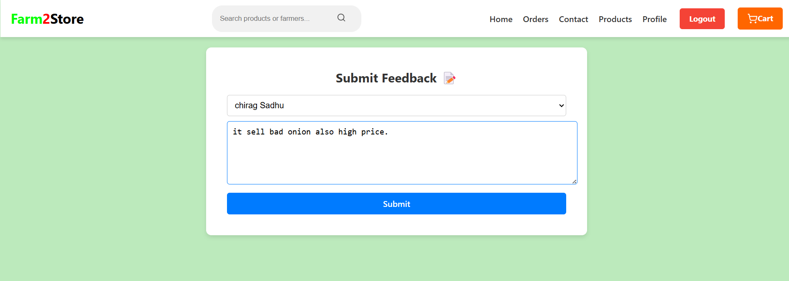
Retailer Provide Feedback to farmer

Slide 28
Farmer Dashboard

Slide 29
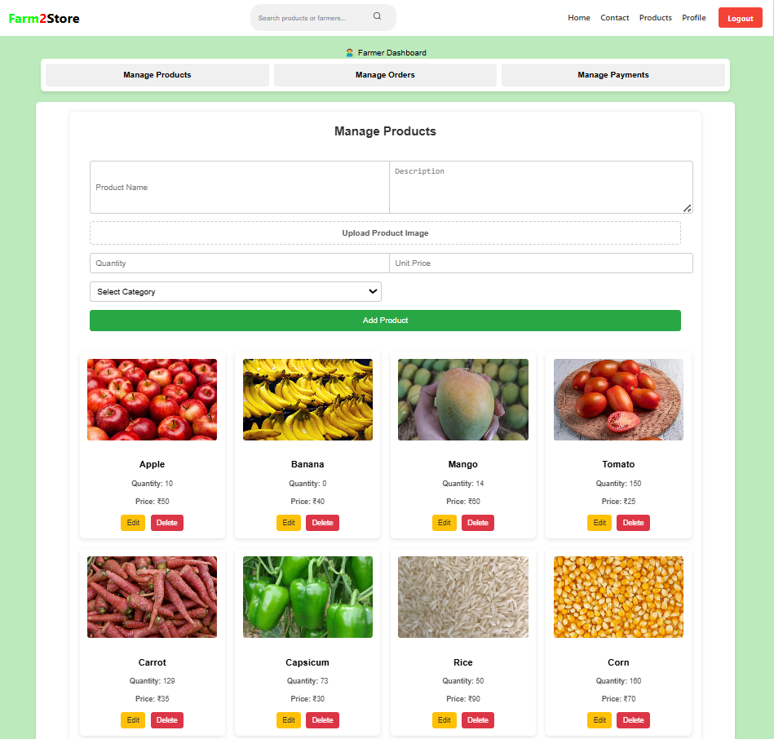
Farmer Dashboard

Slide 30
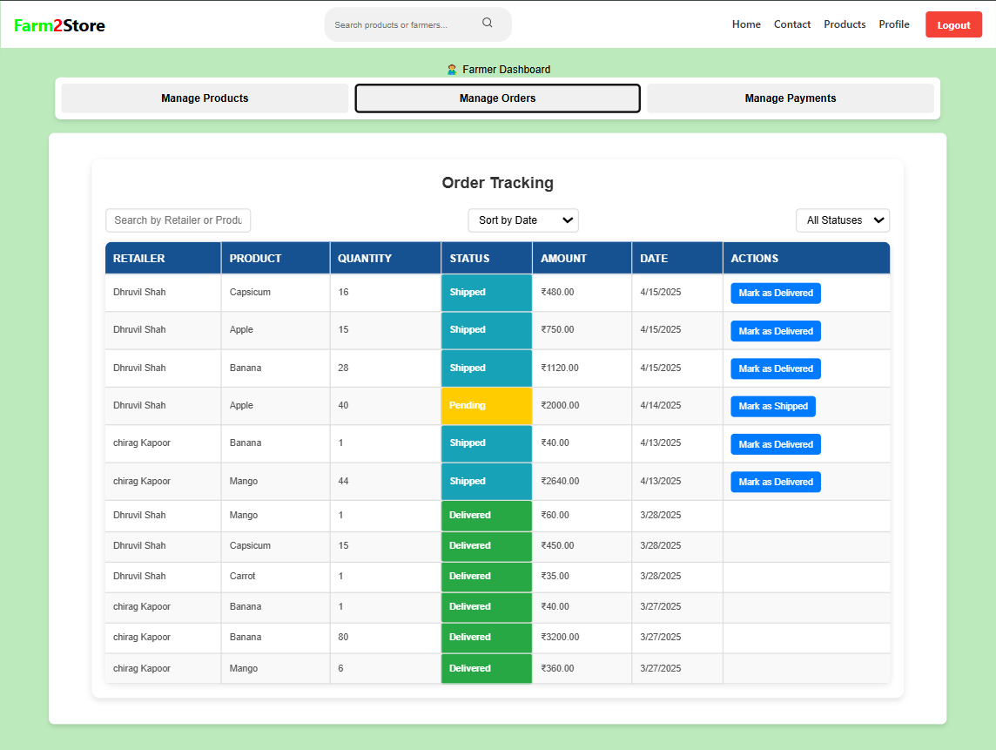
Farmer Dashboard

Slide 31
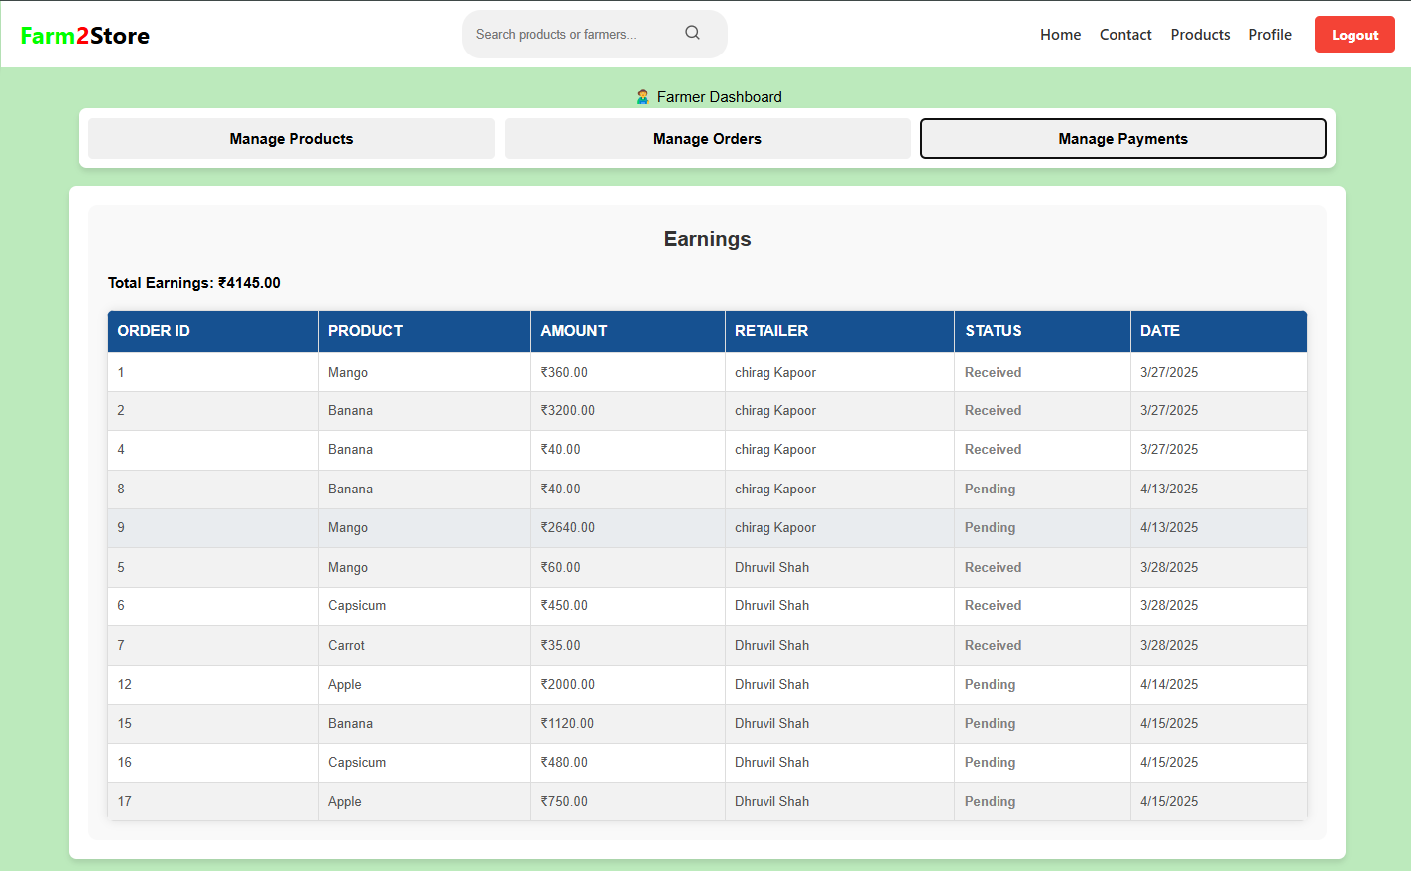
Farmer Dashboard

Slide 32
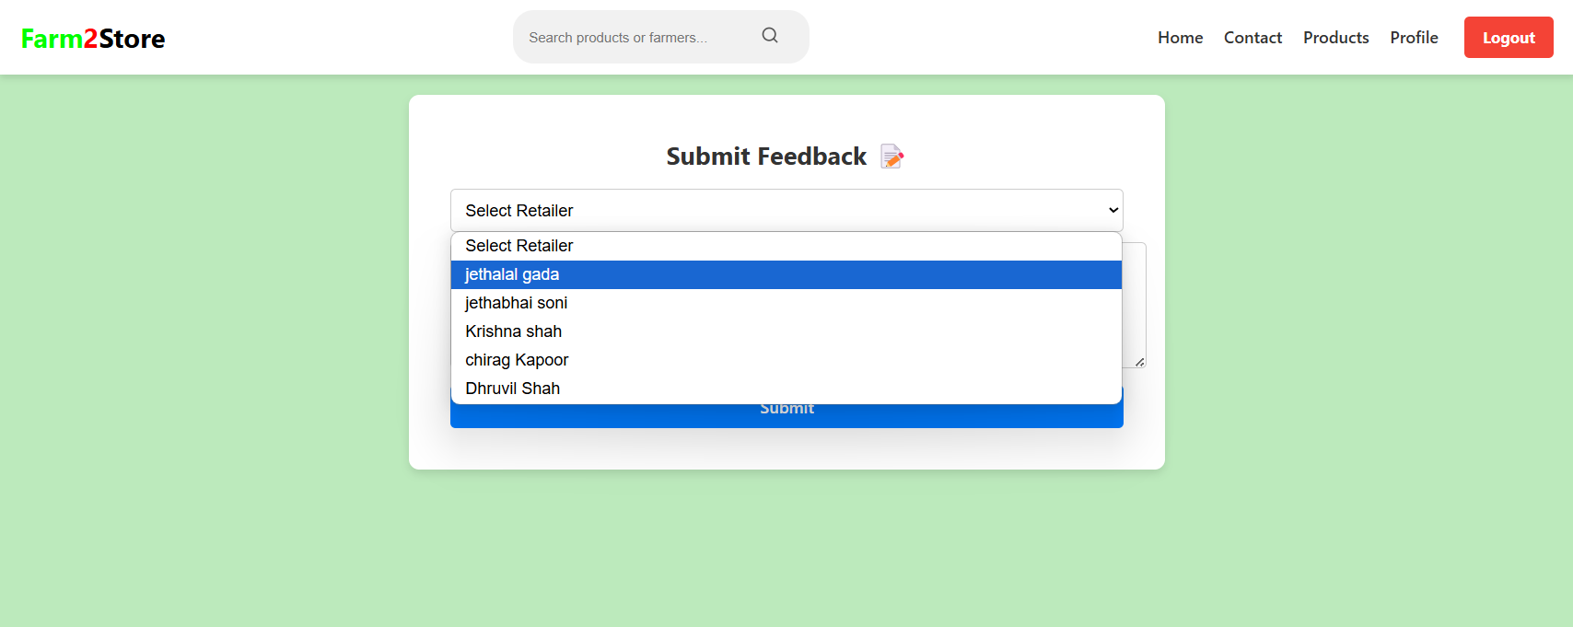
Farmer Provide Feedback to retailer

Slide 33
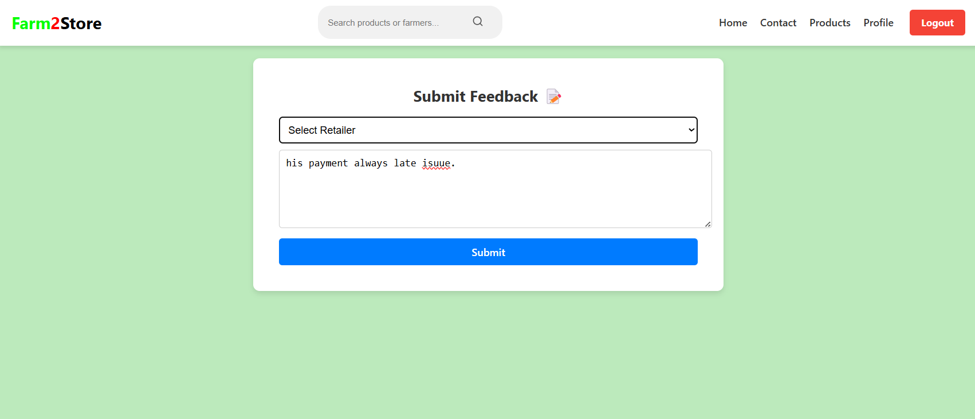
Farmer Provide Feedback to retailer

Slide 34
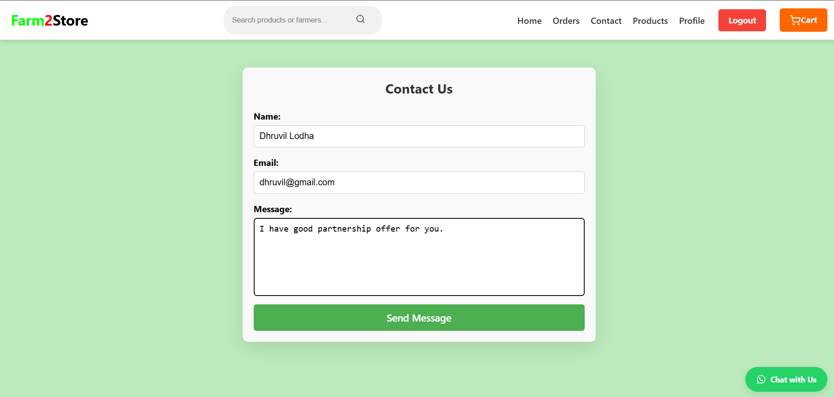
Contact Us Page

Slide 35
Admin Dashboard

Slide 36
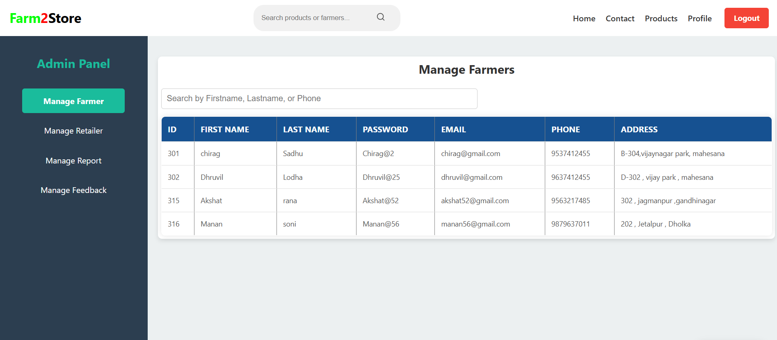
Admin Dashboard: (Manage Farmer)

Slide 37
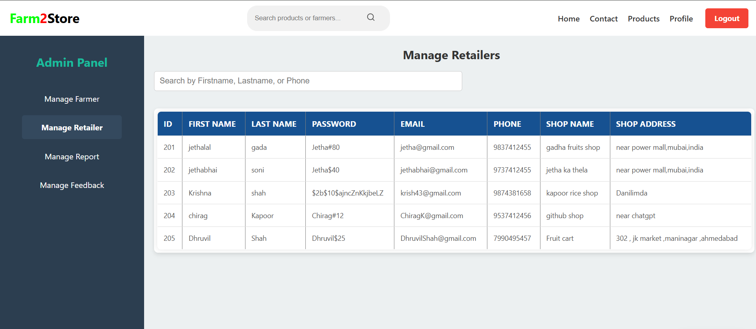
Admin Dashboard: (Manage Retailer)

Slide 38
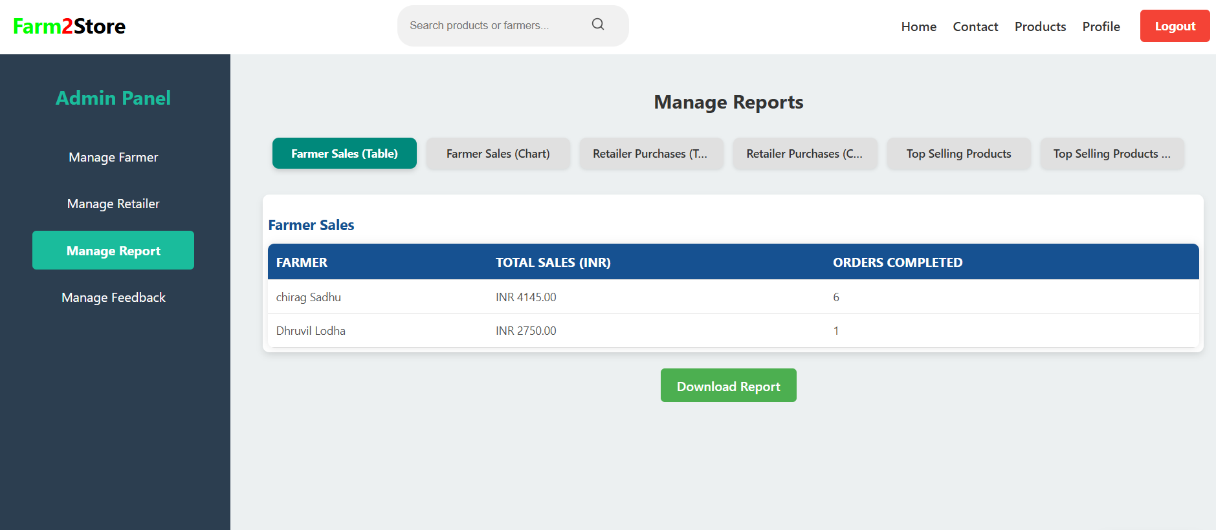
Admin Dashboard: (Manage Report)

Slide 39
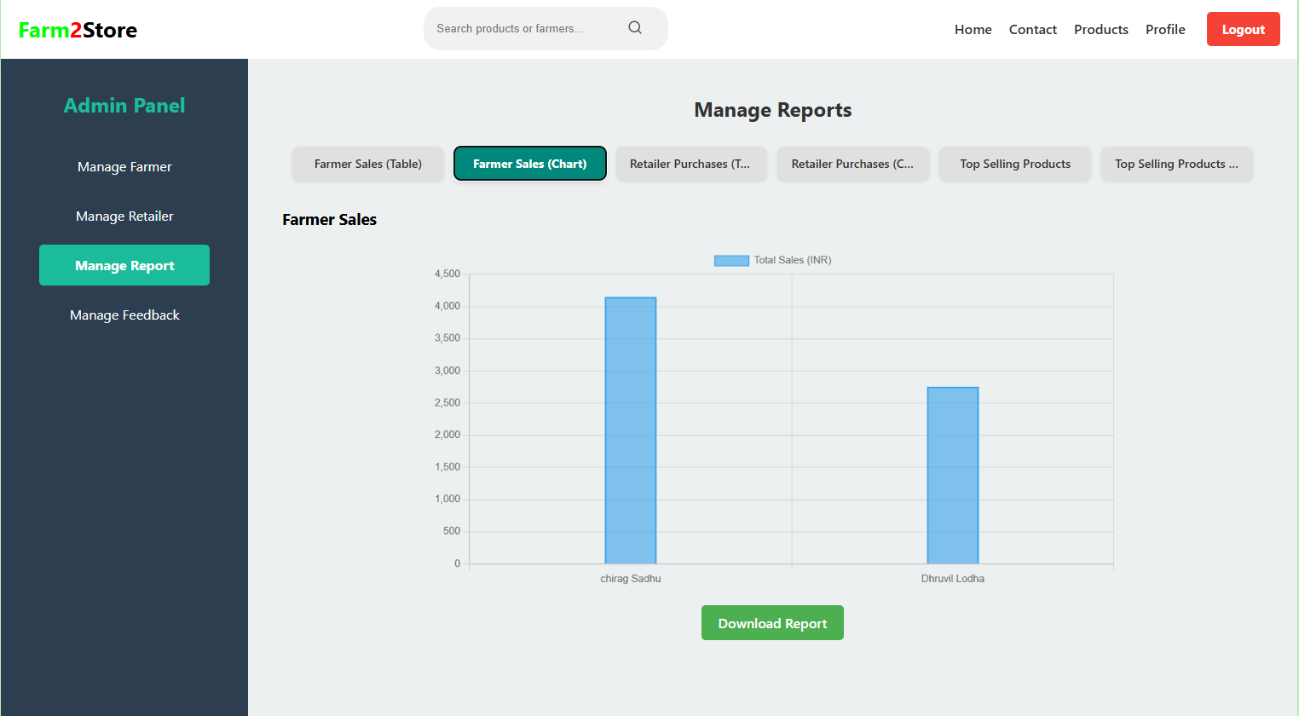
Admin Dashboard: (Manage Report)

Slide 40
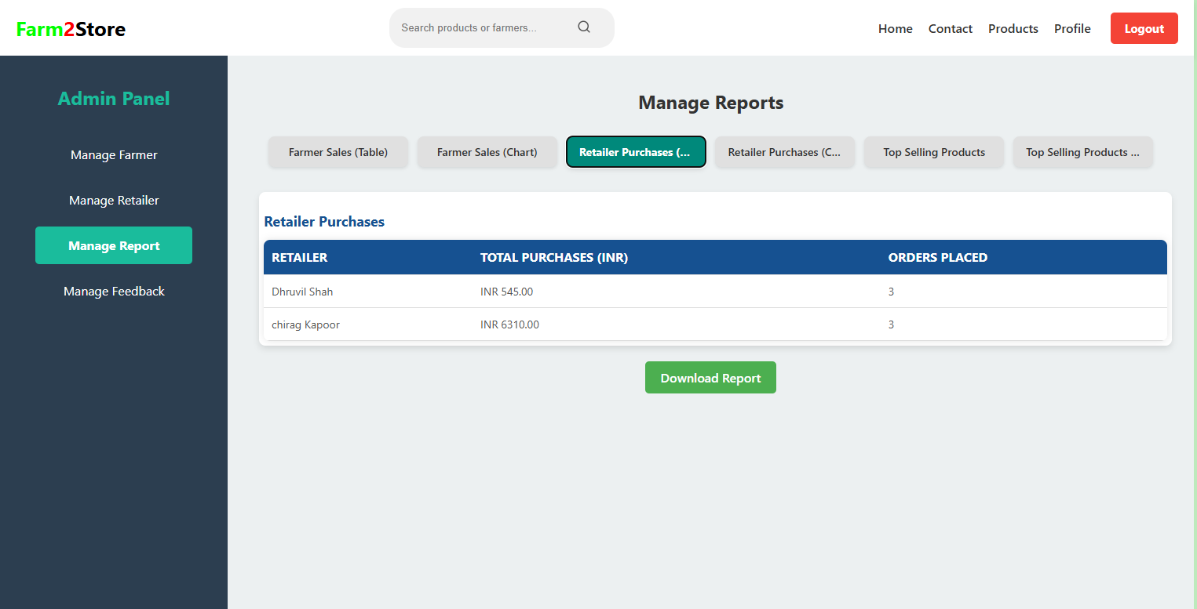
Admin Dashboard: (Manage Report)

Slide 41
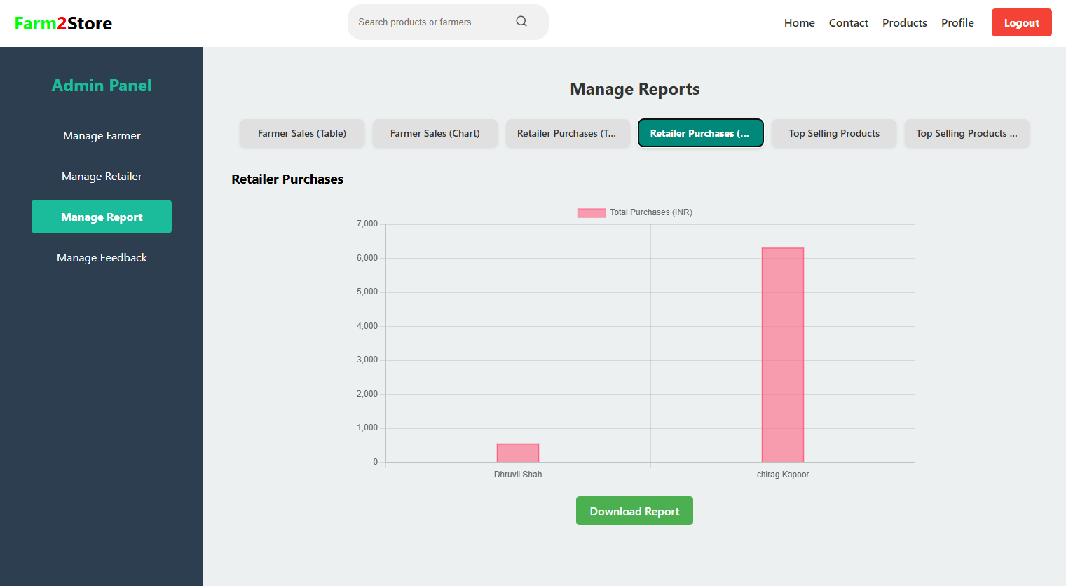
Admin Dashboard: (Manage Report)

Slide 42
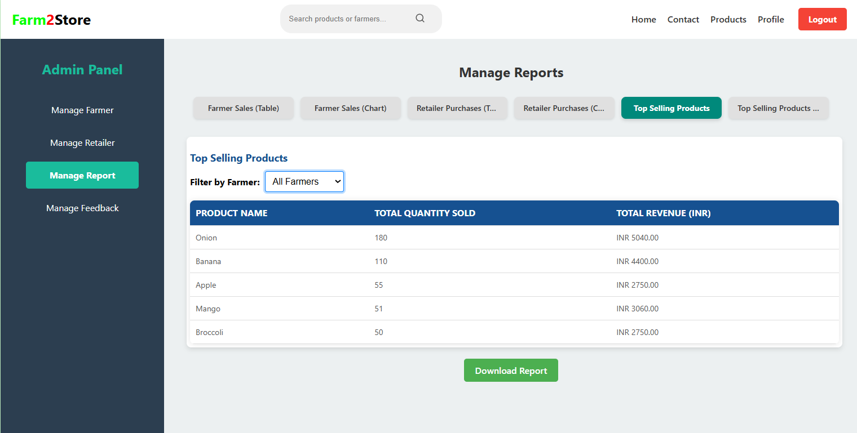
Admin Dashboard: (Manage Report)

Slide 43
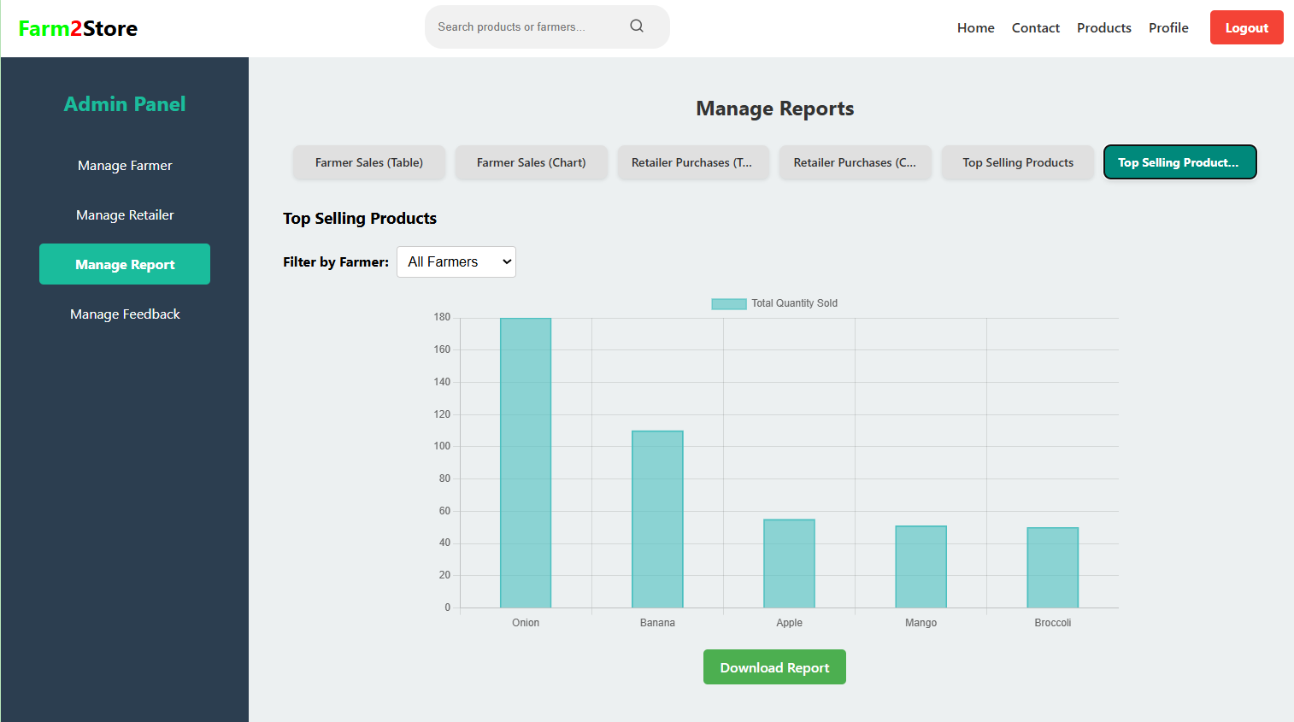
Admin Dashboard: (Manage Report)

Slide 44
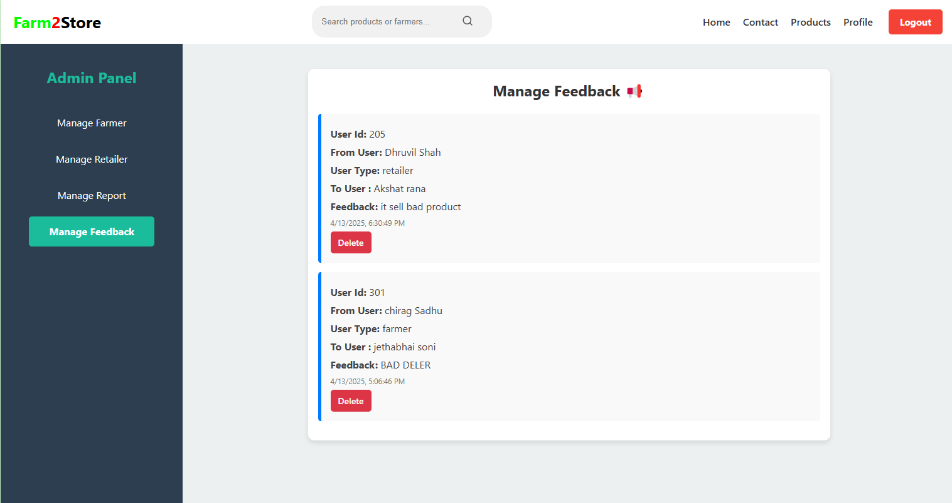
Admin Dashboard: (Manage Report)

Slide 45
Thank You

